Slide 1
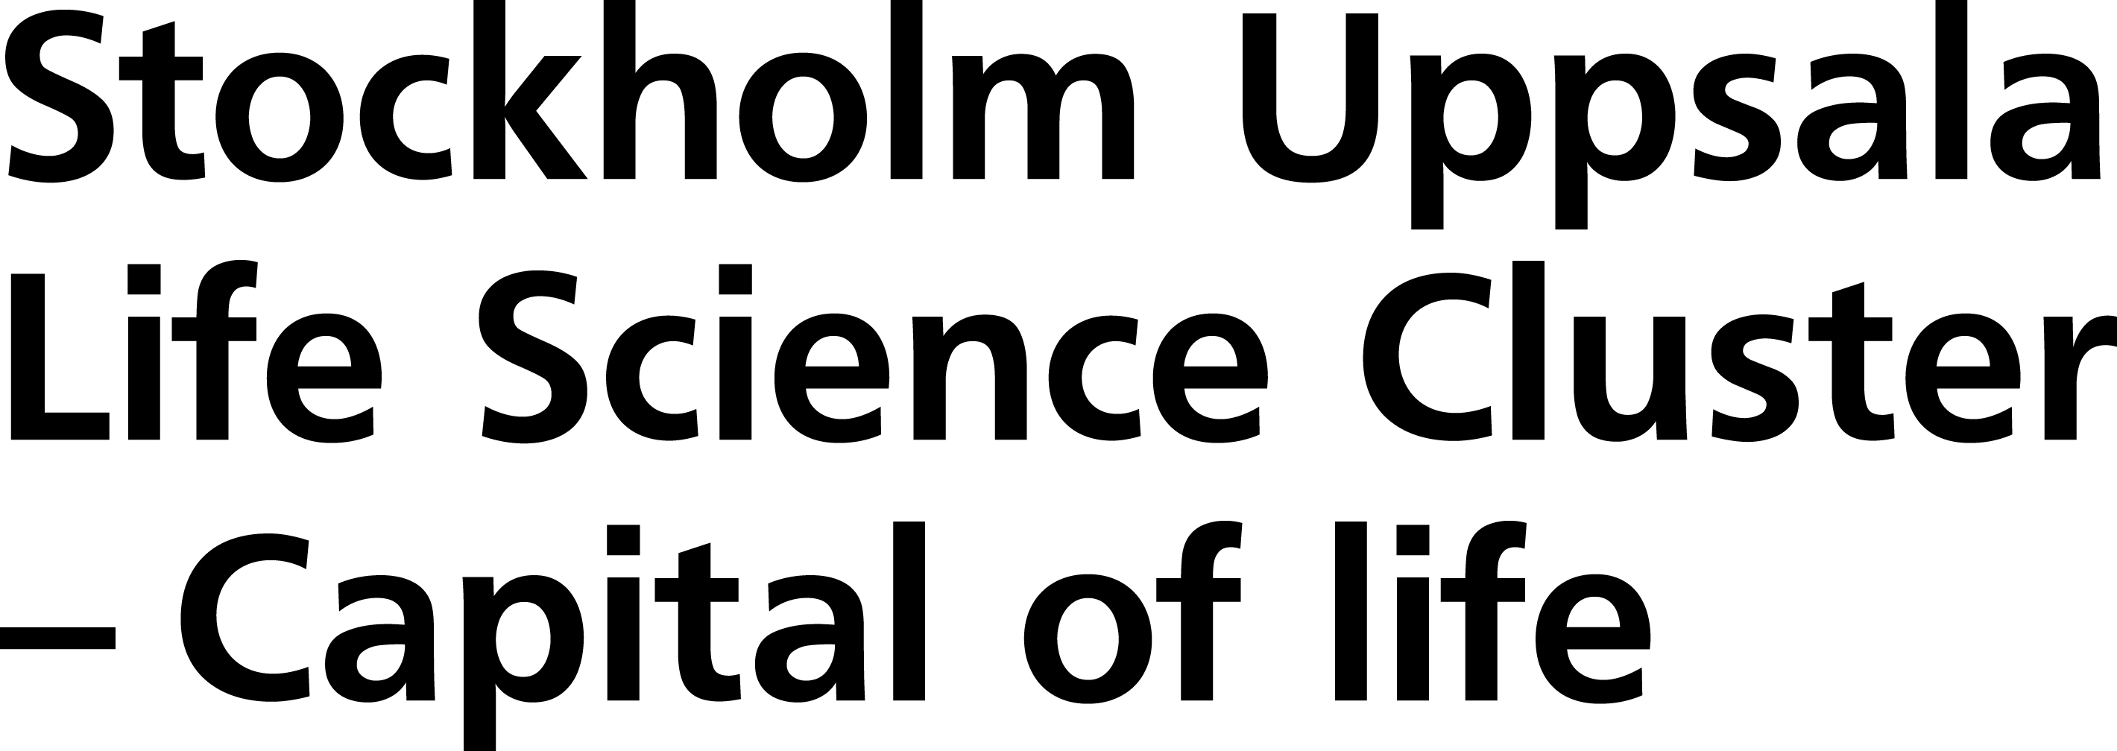
Stockholm-Uppsala
Life Science Cluster
#capitaloflife

Slide 2
Stockholm Uppsala
Life Science Cluster
– Capital of life
#capitaloflife

Slide 3
Capital of Life
Where world-leading science becomes global impact
Stockholm–Uppsala combines world-class research, top-ranked healthcare, entrepreneurial talent and investment capital in one of the world's most innovative environments. From scientific discovery to global companies, this is where life science scales.
#capitaloflife

Slide 4
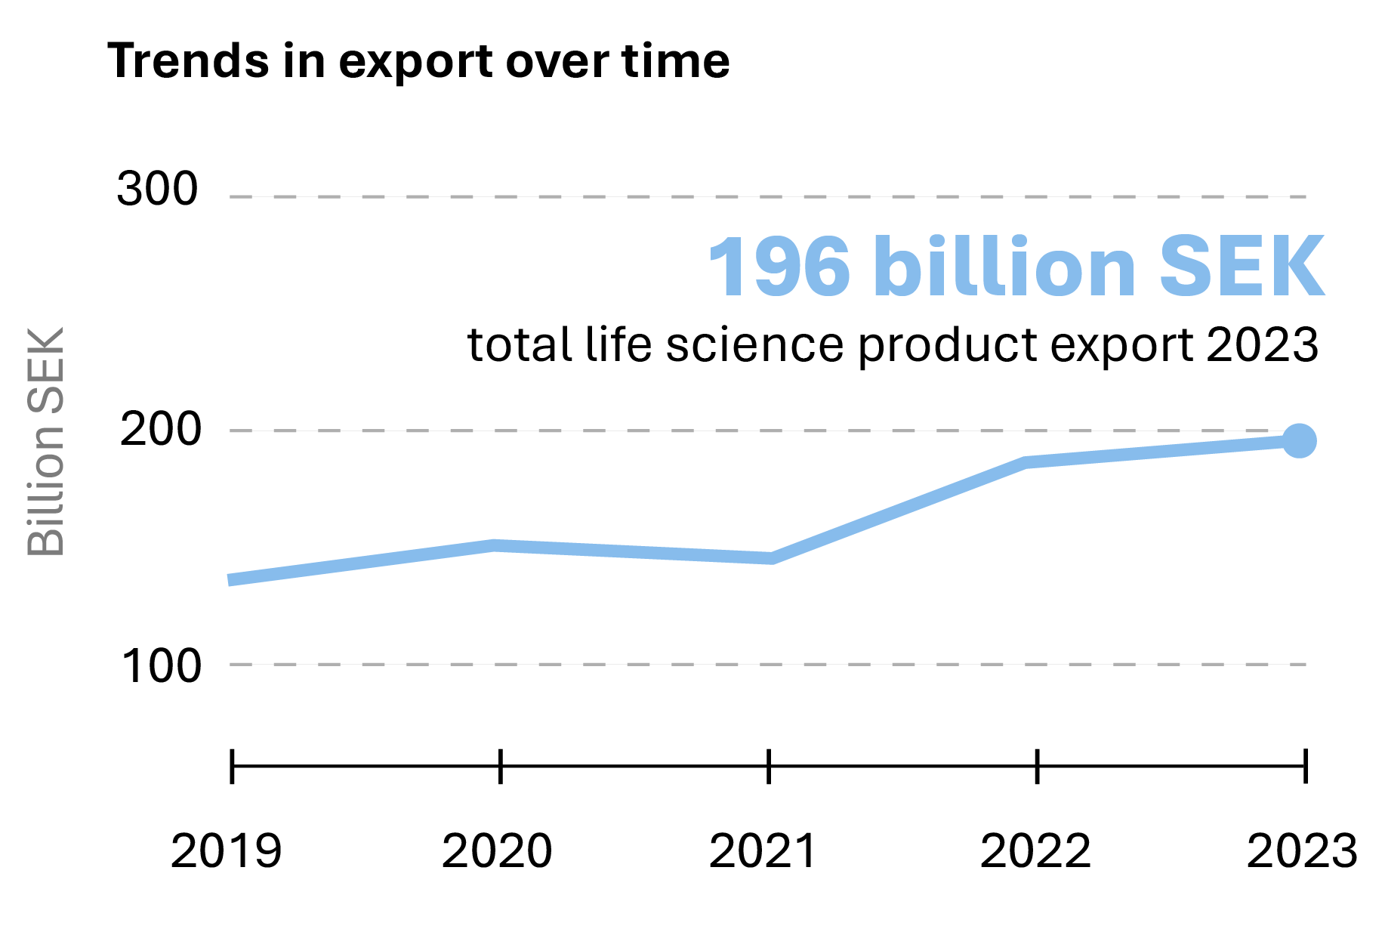
Life Science – Sweden’s second largest goods export category
#capitaloflife
(Sweden BIO, 2026)
Notes:
Life science is Sweden’s second largest goods export category*, with the Stockholm–Uppsala region accounting for nearly two-thirds of the production (SCB, Vinnova, 2023).
*Transport equipment is the largest goods export category in Sweden.
4

Slide 5
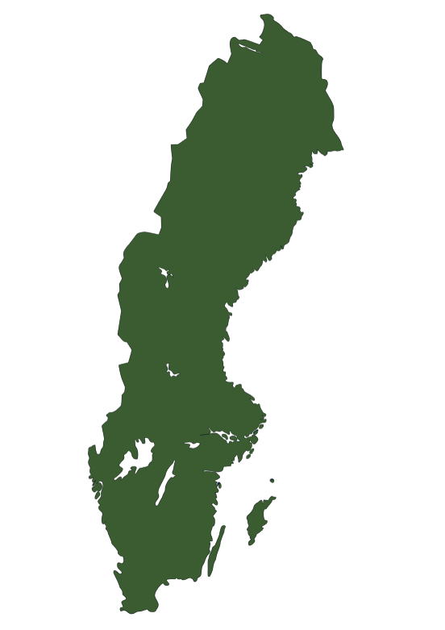
Capital of Life
in numbers:
Home to half of Sweden's Life Science industry
54%
of Swedish life science employees are located
in Stockholm/Uppsala
48%
of Swedish life science companies are located
in Stockholm/Uppsala
#capitaloflife
#capitaloflife
(Vinnova (2025) refers to 2023)
Notes:
48% avser Stockholms län och Uppsala län. Adderas Södermanland, Västmanland och Örebro län summeras det till 51% (Vinnova)

Slide 6
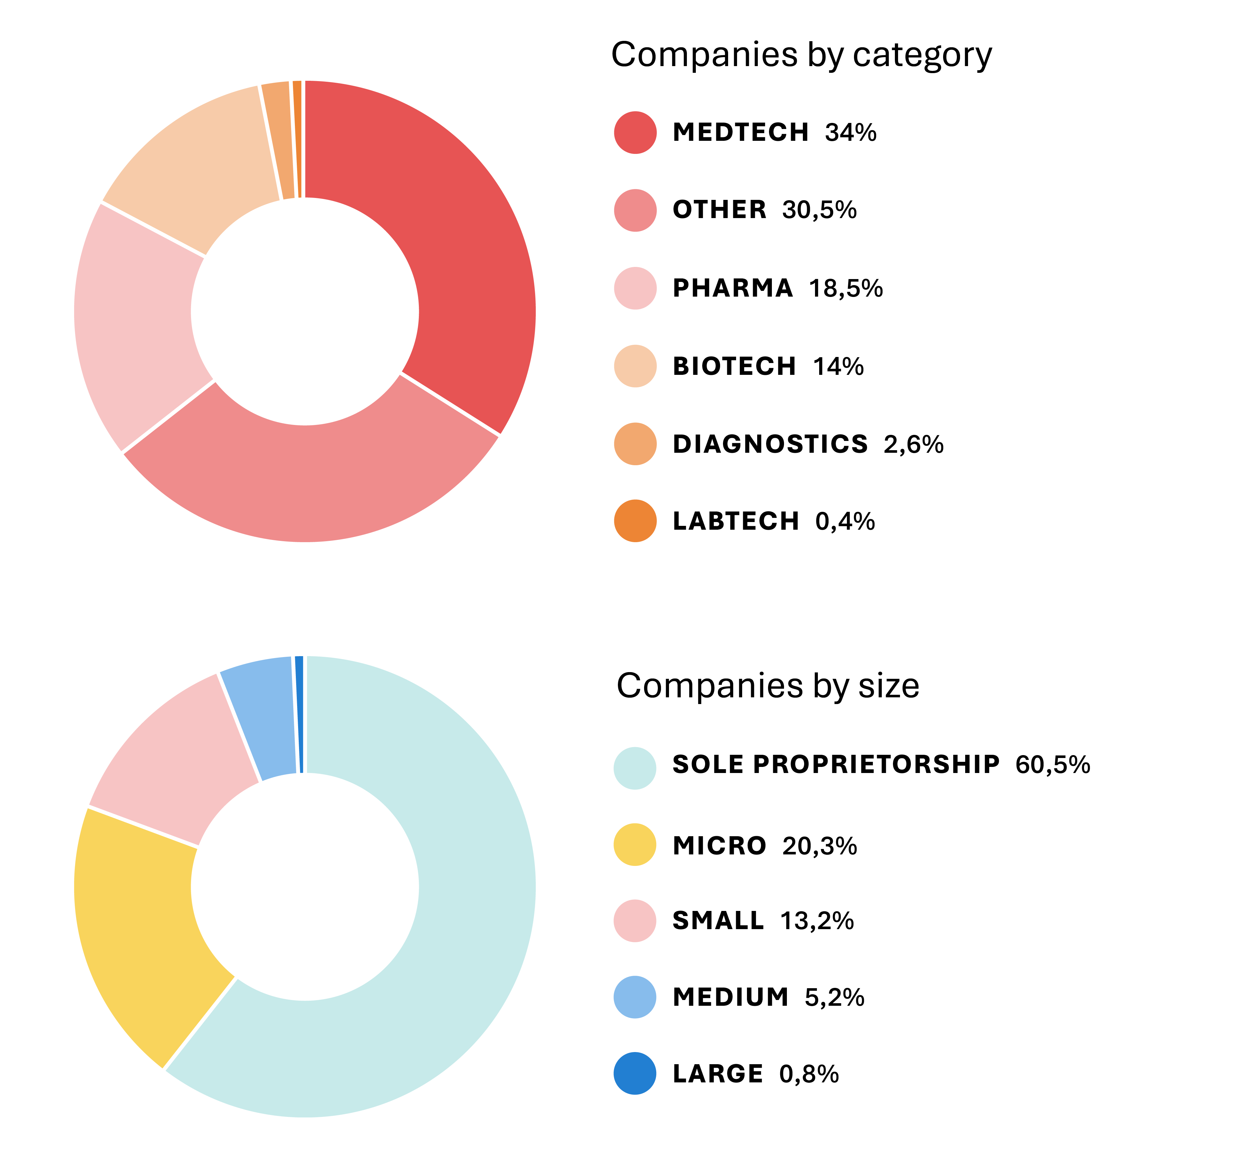
Capital of Life
in numbers: Distribution by category and size
#capitaloflife
(Insight Machine (2025) refers to 2024)
Notes:
Med sole proprietorships avses företag utan registrerade anställda eller företag där uppgifter om antal anställda saknas. Det kan innebära att verksamheten bedrivs av en ensam person eller att företaget exempelvis kan anlita konsulter, underleverantörer eller andra externa samarbetspartners istället för att ha anställd personal.
6

Slide 7









Stockholm Uppsala in numbers:
Academic Excellence at Scale
88 800 students
8 100 doctoral students
2 100 professors
21 000 publications
#capitaloflife
(Annual reports of the universities, 2025)
Notes:
Siffrorna beskriver totalt antal studenter, doktorander, professorer och publikationer på universiteten vars loggor syns på sidan. Siffrorna gäller totalen, inte bara life science.
7

Slide 8

Teachers and researchers own the rights to their research results and inventions – not the university.
This means that researchers at Swedish universities have the freedom to patent, license or commercialise their innovations themselves.
Universities often provide support through innovation offices and subsidiary companies.
The Teacher’s Exemption –
A unique rule in Swedish intellectual property law
#capitaloflife

Slide 9





Life Science – From Swedish research to global impact
BioArctic
Research from Uppsala University → Alzheimer’s therapy (lecanemab) → Global regulatory approvals
Calliditas Therapeutics
Karolinska-linked research → Tarpeyo for IgA nephropathy → US Nasdaq listing & global commercialization
Sobi (Swedish Orphan Biovitrum)
Swedish academic roots → Leader in rare diseases → Worldwide presence
NextCell Pharma (Huddinge)
Karolinska spin-out → Cell therapy (ProTrans) → International clinical development
Biolamina
Karolinska research → Laminin platform technology → Global supplier in regenerative medicine
#capitaloflife
Notes:
9

Slide 10




Life Science – From Swedish research to global impact
Olink proteomics
Uppsala-based research → Advanced proteomics platform → Global precision medicine & pharma partnerships
Orexo
Swedish drug development → Innovative treatments in addiction & CNS → Global commercialization
Recipharm
Swedish pharma expertise → Contract development & manufacturing → Supporting global drug pipelines
Cytiva
Uppsala research heritage → Bioprocessing technologies → Enabling global biologics & vaccine production
#capitaloflife
Notes:
10

Slide 11
Capital of Life: Powered by Sweden
#1 ​
Sweden
European Innovation Scoreboard
EU, 2025
#1
Sweden
Attractiveness for inter- national entrepreneurs
OECD Talent Index, 2023
#1
Sweden
Sustainable investment attractiveness
EIU Sustainability
Index, 2025
#1
Sweden
Unicorn companies per capita in Europe
Dealroom, 2025
#2 ​
Sweden
Global innovation
Global Innovation Index WIPO, 2025
#3 ​
Sweden
R&D investment
Global Innovation Index WIPO, 2025
#capitaloflife
Notes:
#1 Sweden, European Innovation Scoreboard, EU, 2025, referens: https://research-and-innovation.ec.europa.eu/statistics/performance-indicators/european-innovation-scoreboard_en
#1 Sweden, Attractiveness for inter- national entrepreneurs, OECD Talent Index, 2023, referens: https://www.oecd.org/en/publications/what-is-the-best-country-for-global-talents-in-the-oecd_5186ab2d-en.html
#1 Sweden, Sustainable investment attractiveness, EIU Sustainability Index, 2025, referens: https://www.economistgroup.com/press-centre/economist-intelligence/eiu-sustainability-index-2025-sweden-and-switzerland-tied-for-first-place-in-eiu-sustainability-index
#1 Sweden Unicorns per capita in Europe, Dealroom, 2025, referens: https://content.dealroom.co/uploaded/2025/05/Sweden-2024-full-report-1.pdf
#2 ​Sweden Global innovation, Global Innovation Index WIPO, 2025, referens: https://www.wipo.int/gii-ranking/en/Sweden
#3 ​Sweden, R&D investment, Global Innovation Index WIPO, 2025, referens: https://www.wipo.int/web-publications/global-innovation-index-2025/en/gii-2025-results.html
11

Slide 12
Sweden:
Europe’s innovation leader
#1 ​
Sweden
European Innovation Scoreboard
EU, 2025
#capitaloflife
Notes:
#1 Sweden, European Innovation Scoreboard, EU, 2025, referens: https://research-and-innovation.ec.europa.eu/statistics/performance-indicators/european-innovation-scoreboard_en
12

Slide 13
Sweden:
The top destination for global entrepreneurs
#1 ​
Sweden
Attractiveness for international entrepreneurs
OECD Talent Index, 2023
#capitaloflife
Notes:
#1 Sweden, Attractiveness for inter- national entrepreneurs, OECD Talent Index, 2023, referens: https://www.oecd.org/en/publications/what-is-the-best-country-for-global-talents-in-the-oecd_5186ab2d-en.html
13

Slide 14
Sweden:
The sustainable investment leader
#1 ​
Sweden
Sustainable investment attractiveness
EIU Sustainability
Index, 2025
#capitaloflife
Notes:
#1 Sweden, Sustainable investment attractiveness, EIU Sustainability Index, 2025, referens: https://www.economistgroup.com/press-centre/economist-intelligence/eiu-sustainability-index-2025-sweden-and-switzerland-tied-for-first-place-in-eiu-sustainability-index
14

Slide 15
Sweden:
Europe’s unicorn factory
#1 ​
Sweden
Unicorn companies per capita in Europe
Dealroom, 2025
#capitaloflife
Notes:
#1 Sweden Unicorns per capita in Europe, Dealroom, 2025, referens: https://content.dealroom.co/uploaded/2025/05/Sweden-2024-full-report-1.pdf
15

Slide 16
Sweden:
A global innovation leader
#2 ​
Sweden
Global innovation
Global Innovation Index WIPO, 2025
#capitaloflife
Notes:
#2 ​Sweden Global innovation, Global Innovation Index WIPO, 2025, referens: https://www.wipo.int/gii-ranking/en/Sweden
16

Slide 17
Sweden:
A global leader in R&D investment
#3 ​
Sweden
R&D investment
Global Innovation Index WIPO, 2025
#capitaloflife
Notes:
#3 ​Sweden, R&D investment, Global Innovation Index WIPO, 2025, referens: https://www.wipo.int/web-publications/global-innovation-index-2025/en/gii-2025-results.html
17

Slide 18
Stockholm: Europe’s most innovative region
#1 ​
Stockholm
European Regional Innovation Scoreboard
EU, 2025
#capitaloflife
Notes:
#1 ​Stockholm, European Regional Innovation Scoreboard, EU, 2025, referens: https://research-and-innovation.ec.europa.eu/statistics/performance-indicators/regional-innovation-scoreboard_en
18

Slide 19
Karolinska University Hospital:
Europe’s best hospital
#1 ​
Karolinska University Hospital Europe's Best Hospitals
Newsweek, 2026
#capitaloflife
Notes:
#1 Karolinska Universitetssjukhuset, Europe's Best Hospitals, Newsweek, 2026, referens: https://rankings.newsweek.com/worlds-best-hospitals-2026
19

Slide 20
Stockholm: Europe’s venture capital leader
#1 ​
Stockholm
Venture capital per capita in the EU
Stockholm Chamber of Commerce, 2025
#capitaloflife
Notes:
#1 Stockholm, Venture capital per capita in the EU, Stockholm Chamber of Commerce, 2025, referens: https://stockholmshandelskammare.se/rapporter/stockholm-varldens-basta-huvudstad/#report-toc (tabell 2, refererar till 2020-2024.)
20

Slide 21
Stockholm:
One of the world’s best cities for work-life balance
#3 ​
Stockholm
Worldwide Work-Life Balance Index, Forbes, 2023
#capitaloflife
Notes:
#3 Stockholm, Worldwide Work-Life Balance Index, Forbes, 2023, referens: https://www.forbes.com/advisor/uk/business/work-life-balance-index/
21

